Slide 1
Offline Signature Verification with Convolutional Neural Networks
Fatma BOUZGHAIA
Marouane KACHOURI

Slide 2
1.
What is a CNN?

Slide 3
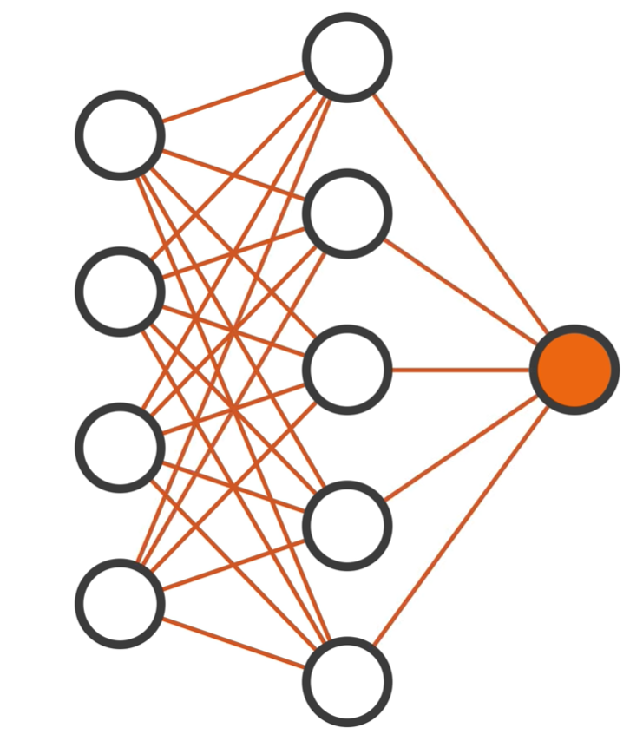
Input
Layer
Output
Layer
Hidden
Layer

Slide 4
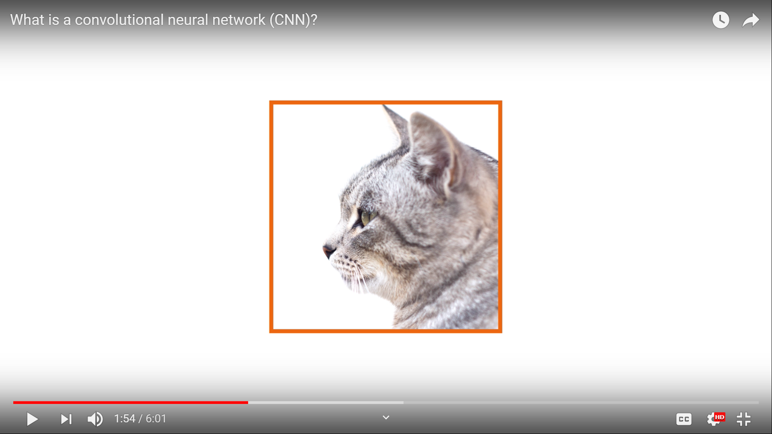
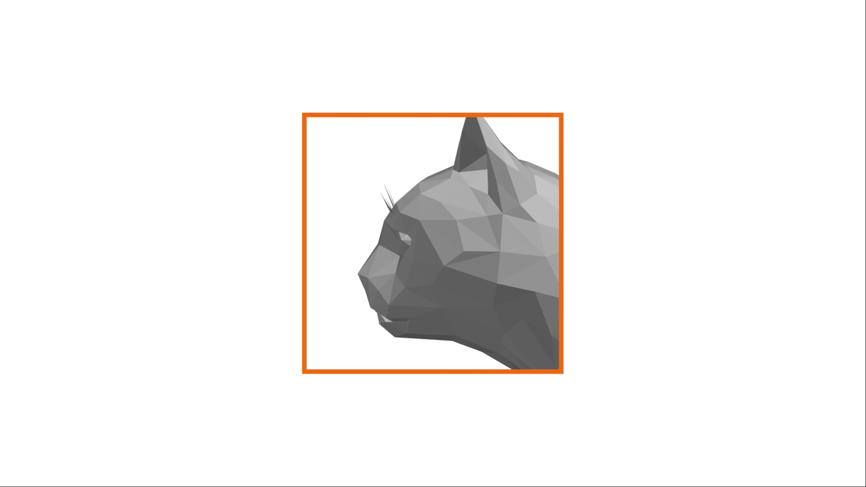
Filtering

Slide 5
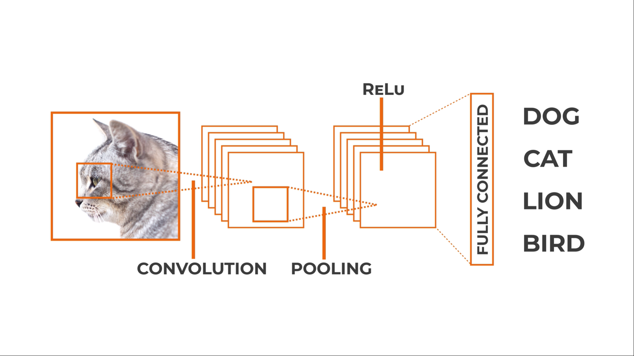
CNN Architecture

Slide 6
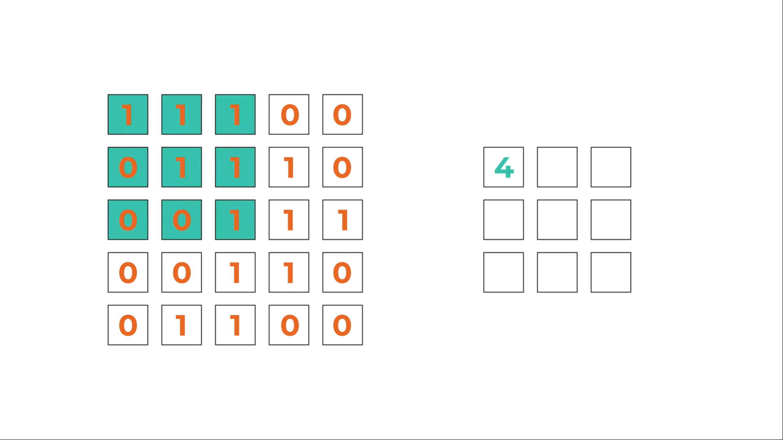
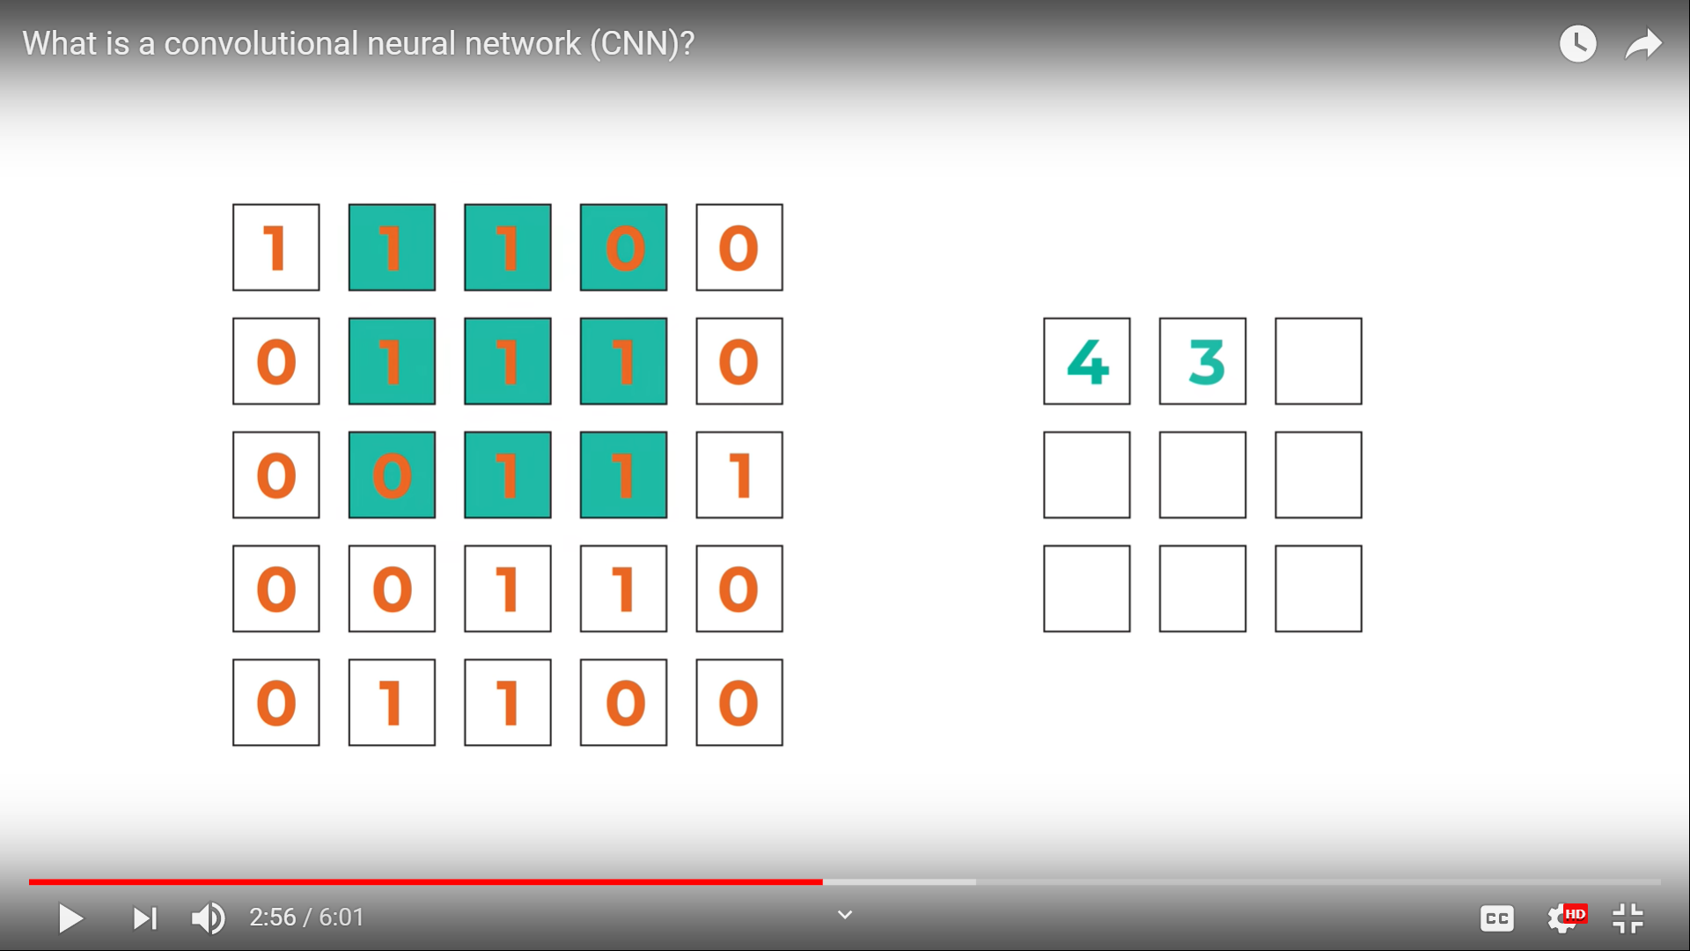
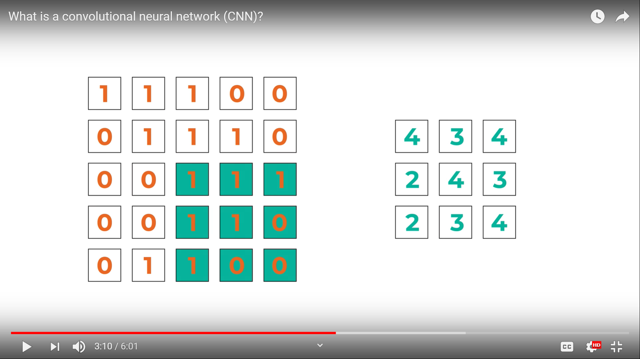
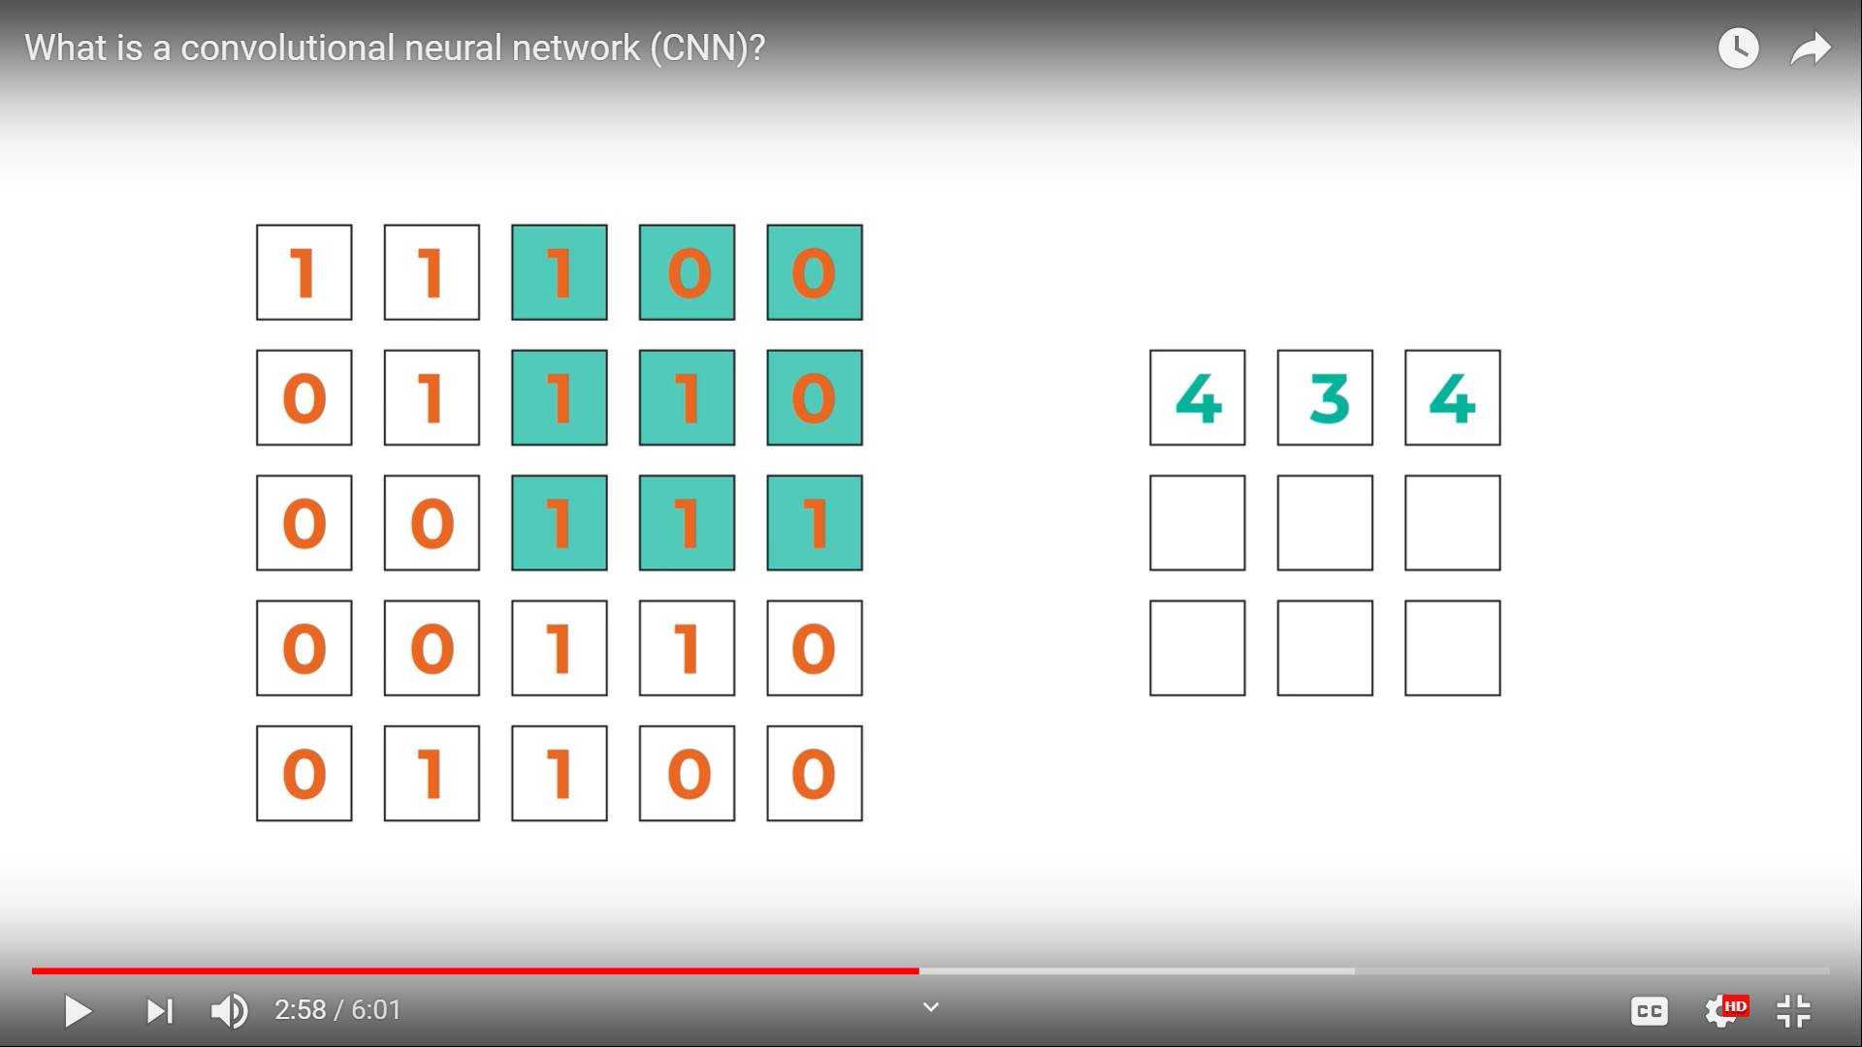
Convolution layer
Notes:
Filters

Slide 7
Convolution layer
Convolving
Filters
Flattening

Slide 8
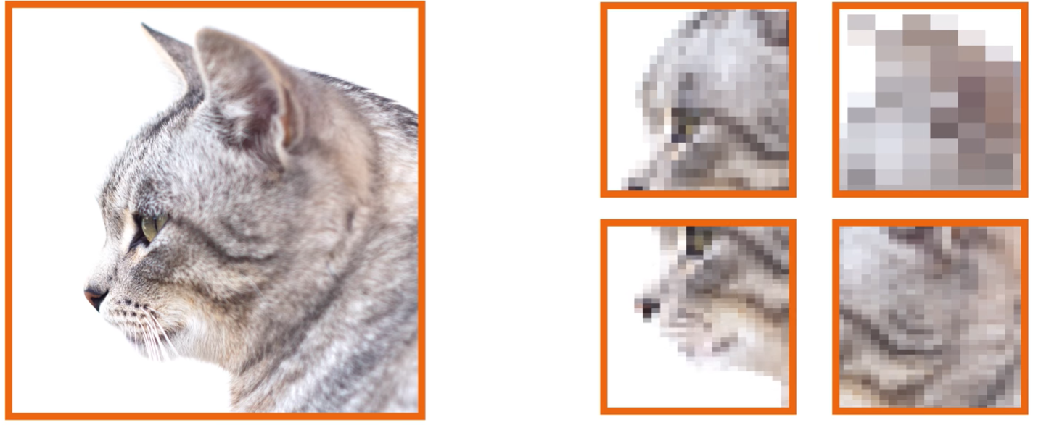
Pooling layer
Max pooling, average pooling…
Notes:
Reducing parameters, speeding up calculations 🡺 feature extraction

Slide 9
Convolution layer
Stride
Padding

Slide 10
Fully connected layer
Classification
Linear data
Flattening

Slide 11
2.
Alvarez 2016

Slide 12
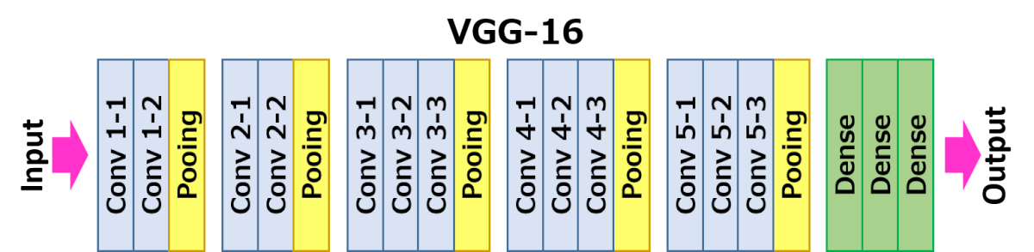
VGG 16 Architecture
Notes:
There are 13 convolutional layers, 5 Max Pooling layers and 3 Dense layers which sums up to 21 layers but only 16 weight layers.
Conv 1 has number of filters as 64 while Conv 2 has 128 filters, Conv 3 has 256 filters while Conv 4 and Conv 5 has 512 filters.

Slide 13
Loss function, transfer learning
Notes:
There are 13 convolutional layers, 5 Max Pooling layers and 3 Dense layers which sums up to 21 layers but only 16 weight layers.
Conv 1 has number of filters as 64 while Conv 2 has 128 filters, Conv 3 has 256 filters while Conv 4 and Conv 5 has 512 filters.

Slide 14
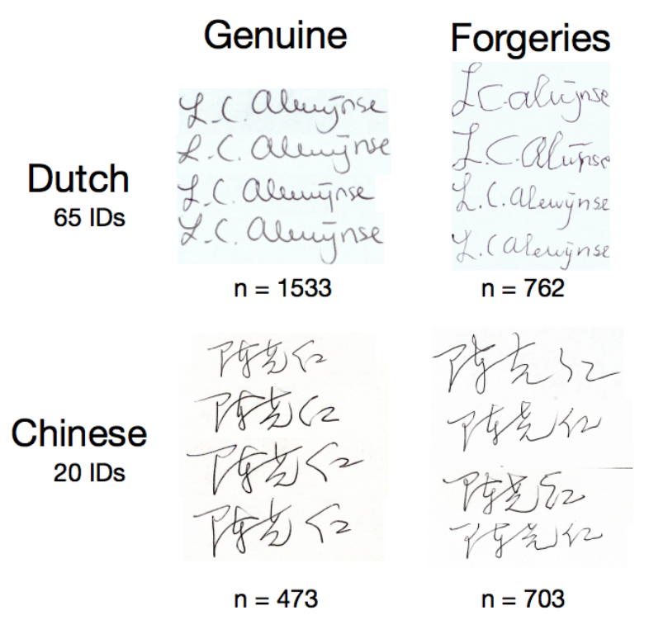
Datasets Used
SigComp 2011 dataset :
366 images of Dutch signers for 10 IDs.
576 images of Chinese signers for 10 IDs.
Notes:
There are 13 convolutional layers, 5 Max Pooling layers and 3 Dense layers which sums up to 21 layers but only 16 weight layers.
Conv 1 has number of filters as 64 while Conv 2 has 128 filters, Conv 3 has 256 filters while Conv 4 and Conv 5 has 512 filters.

Slide 15
Results (⅓)
All data in the SigCOMP dataset are labelled as either genuine or forged signatures without the identity of the signer.
Validation
Test
 | Dutch Result | Chinese Result
Accuracy | 97% | 95%
FAR | 3.6% | 4.7%
FRR | 3.6% | 5.6%
 | Dutch Result | Chinese Result
Accuracy | 94% | 88%
FAR | 13.32% | 8.2%
FRR | 3.13% | 18.2%
Notes:
They evaluate the performance of the network using 3 metrics: Accuracy, False Acceptance Rate, False Rejection Rate.
Higher accuracy is better and lower FAR and FRR are better. But the most important is to achieve low FAR scores

Slide 16
Results (⅔)
Training the network with the same dataset.
Validation and test sets : new people’s signatures and forgeries by new people not in the dataset.
Validation
Test
 | Dutch Result
Accuracy | 73%
FAR | 22.2%
FRR | 28.3%
 | Dutch Result
Accuracy | 76%
FAR | 28.6%
FRR | 21.8%
Notes:
They evaluate the performance of the network using 3 metrics: Accuracy, False Acceptance Rate, False Rejection Rate.
Higher accuracy is better and lower FAR and FRR are better. But the most important is to achieve low FAR scores

Slide 17
Results (3/3)
Writer-Dependant Comparison Task:
10 genuine signatures, 25 questioned signatures.
Goal: the network classify the questioned signatures
Validation
 | Dutch Result
Accuracy | 67.1%
FAR | 33%
FRR | 33%
Notes:
They evaluate the performance of the network using 3 metrics: Accuracy, False Acceptance Rate, False Rejection Rate.
Higher accuracy is better and lower FAR and FRR are better. But the most important is to achieve low FAR scores

Slide 18
3.
Haffeman 2018

Slide 19
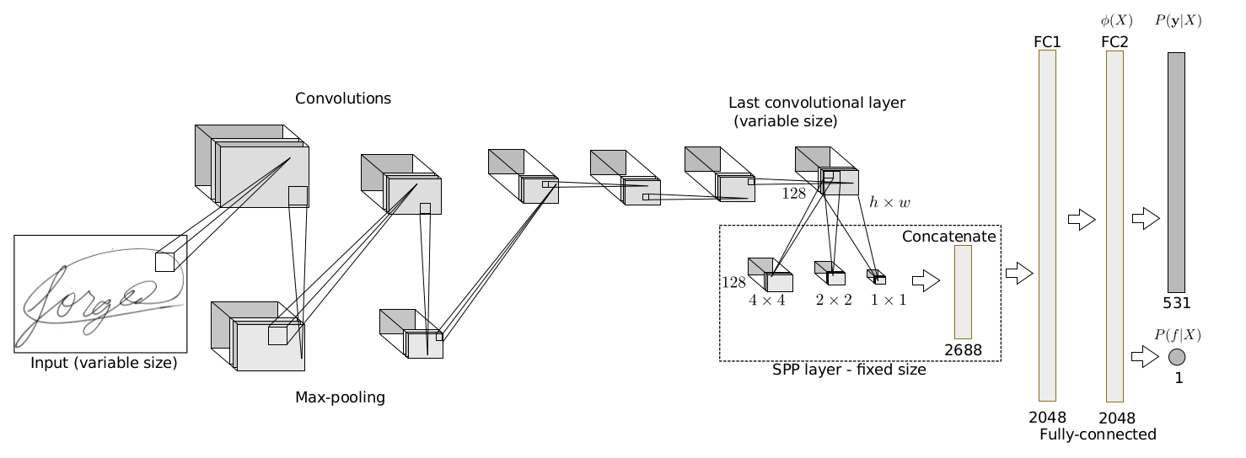
Architecture
Notes:
The input signature (of variable size) is transformed in a sequence of convolution and max-pooling operations. The last convolutional layer results in 128 maps of size h × w (the actual size varies according to the signature size). The Spatial Pyramid Pooling layer (SPP) is then used to obtain a fixed-sized representation, by adapting the size of pooling regions, to obtain pooled results in three sizes: 4 × 4, 2 × 2 and 1 × 1. These are concatenated in a single vector of size 21 × 128 = 2688 units, which is then used as input to the fully-connected layers. During training, the network outputs P (y|X) (and, if forgeries are used during training, also P (f |X)), and the network is trained to minimize the cross-entropy with respect to the training dataset. For obtaining representations for new signatures, we perform forward propagation until the last layer before softmax, obtaining φ(X), a vector of 2048 dimensions, regardless of the signature size.

Slide 20
Datasets Used
GPDS
MCYT: containing signatures of 75 individuals. The sub corpus contains 15 genuine and 15 forgeries against each signer and total of 2250 signatures
CEDAR: consists of scanned pages of handwriting samples provided by 1,568 individuals. There are three samples per writer.
Brazilian PUC-PR dataset: contains signatures from 168 users, and forgeries for the ﬁrst 60 users.
Two synthetic datasets:
Bengali
Devanagri scripts
Notes:
There are 13 convolutional layers, 5 Max Pooling layers and 3 Dense layers which sums up to 21 layers but only 16 weight layers.
Conv 1 has number of filters as 64 while Conv 2 has 128 filters, Conv 3 has 256 filters while Conv 4 and Conv 5 has 512 filters.

Slide 21
Results
error for 100dpi images: 2.10%
error for 300dpi images: 0.4% (in case of training with forgeries)
increasing resolution has no effect when training only with genuine signatures
Best results: 2.85% EER on online and 3% EER for offline signatures
Notes:
They evaluate the performance of the network using 3 metrics: Accuracy, False Acceptance Rate, False Rejection Rate.
Higher accuracy is better and lower FAR and FRR are better. But the most important is to achieve low FAR scores

Slide 22
4.
Tekerek 2019

Slide 23
Architecture
Conv 2-1
Conv 1-1
Conv 1-2
Pooling
Conv 2-2
Conv 2-3
Pooling
Dense 1-1
Dropout 0.5
Dense 1-2
Dropout 0.5
Dense 1-3

Slide 24
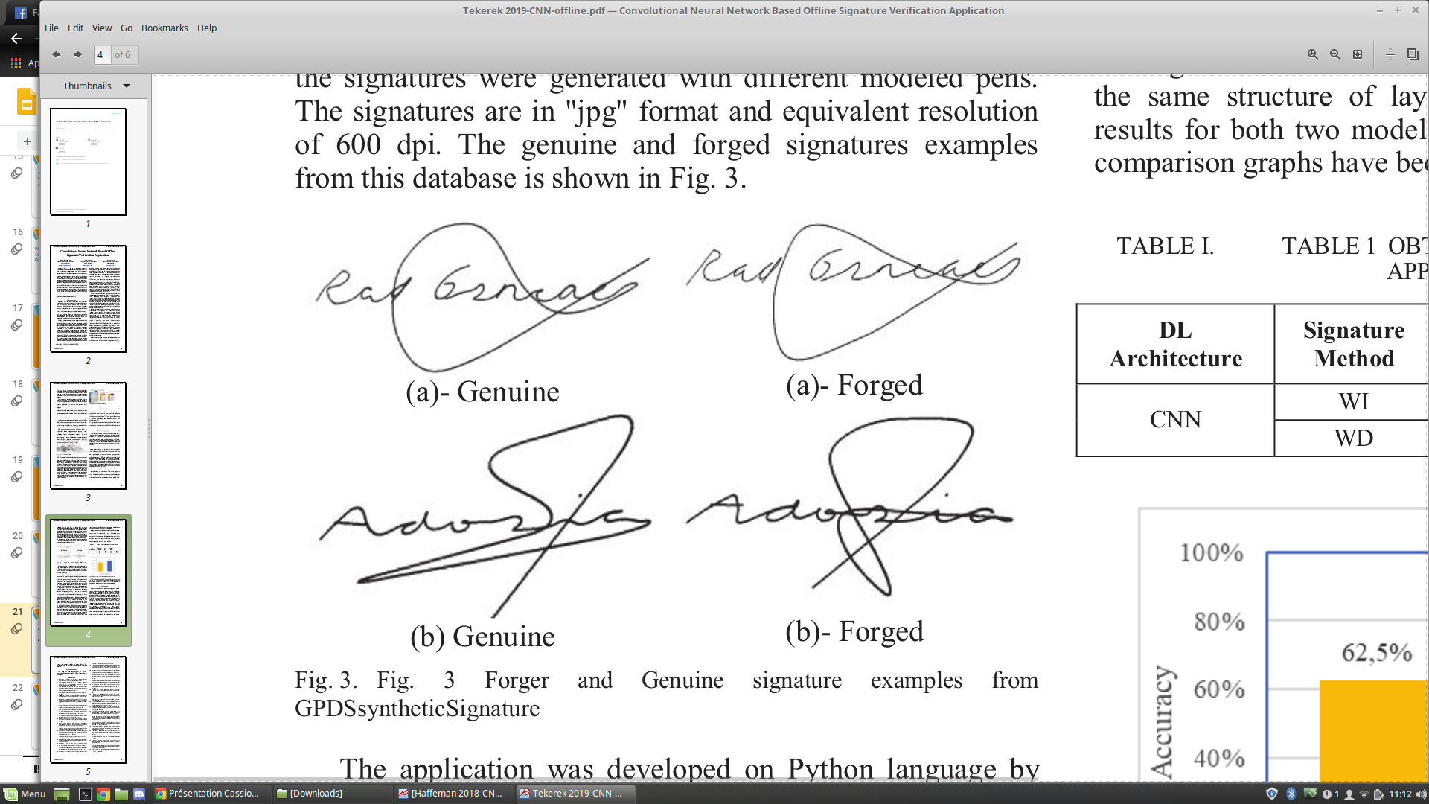
Datasets Used
GPDSsyntheticSignatures
4000 different individuals:
24 genuine signatures.
30 samples of forged signatures.
Notes:
There are 13 convolutional layers, 5 Max Pooling layers and 3 Dense layers which sums up to 21 layers but only 16 weight layers.
Conv 1 has number of filters as 64 while Conv 2 has 128 filters, Conv 3 has 256 filters while Conv 4 and Conv 5 has 512 filters.

Slide 25
Results
CNN was trained via WD and WI signatures.
 | WI | WD
Test data | 240 | 24
Training data | 300: 150 genuine + 150 forgeries | 30: 15 genuine + 15 forgeries
Accuracy | 62.5% | 75%
Notes:
They evaluate the performance of the network using 3 metrics: Accuracy, False Acceptance Rate, False Rejection Rate.
Higher accuracy is better and lower FAR and FRR are better. But the most important is to achieve low FAR scores

Slide 26
5.
SigNet: Convolutional Siamese Network for Writer Independant Offline Signature Verification
Lundi 9 Mars 2020

Slide 27
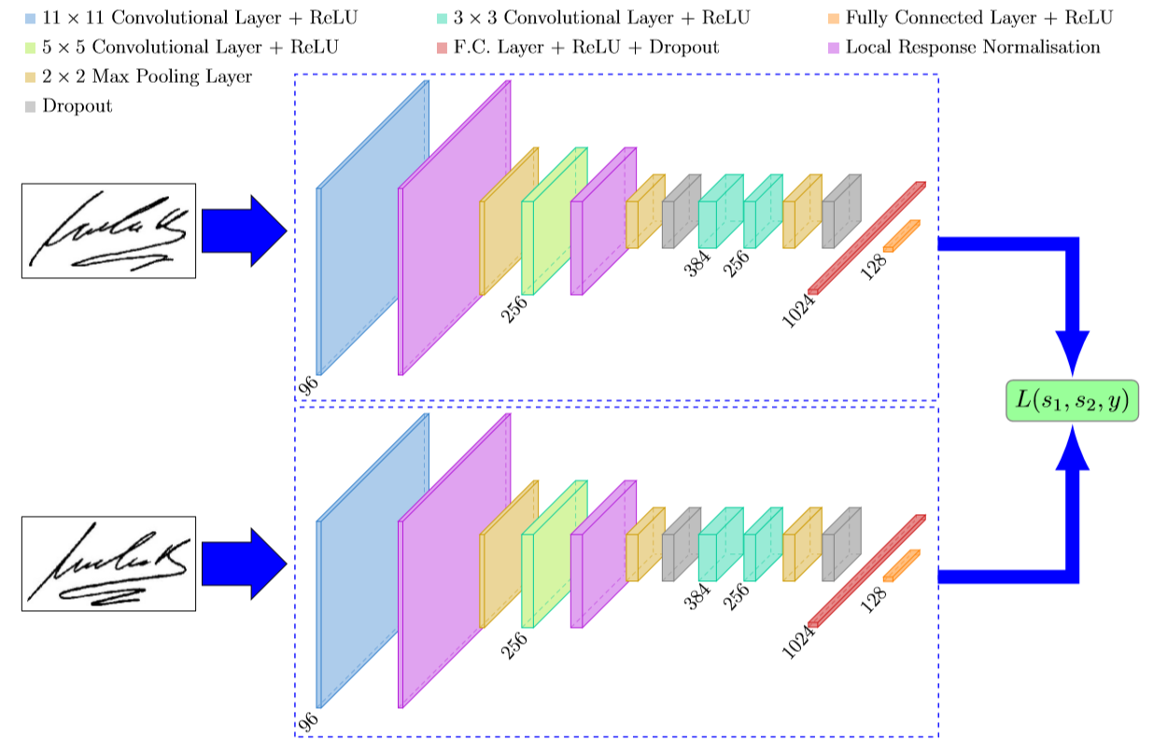
Architecture

Slide 28
Loss Function
L(s1,s2,y) = α(1−y)D²_{w} + βy max(0,m−D_{w})²
s1, s2: samples (signature images)
y: binary indicator function denoting whether the two samples belong to the same class or not
α, β: constants
m: margin (equal to 1 in our case)
D_{w} = ||f(s1;w1)−f(s2;w2)||₂ : Euclidean distance computed in the embedded feature space
f : embedding function that maps a signature image to real vector space through CNN
w1, w2 are the learned weights for a particular layer

Slide 29
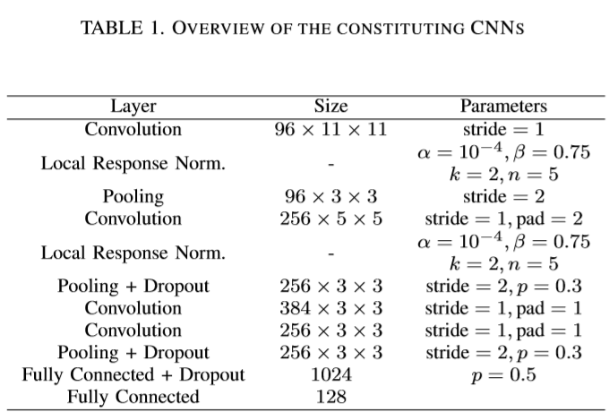
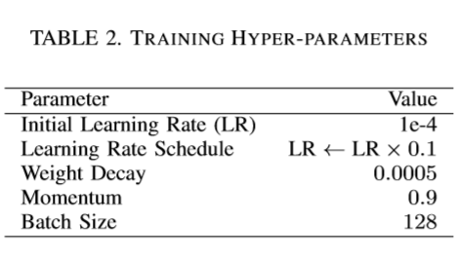
Architecture details
bias=0
Notes:
They evaluate the performance of the network using 3 metrics: Accuracy, False Acceptance Rate, False Rejection Rate.
Higher accuracy is better and lower FAR and FRR are better. But the most important is to achieve low FAR scores

Slide 30
Datasets
CEDAR
GPDS300
GPDS Synthetic
BHSig260
Notes:
They evaluate the performance of the network using 3 metrics: Accuracy, False Acceptance Rate, False Rejection Rate.
Higher accuracy is better and lower FAR and FRR are better. But the most important is to achieve low FAR scores

Slide 31
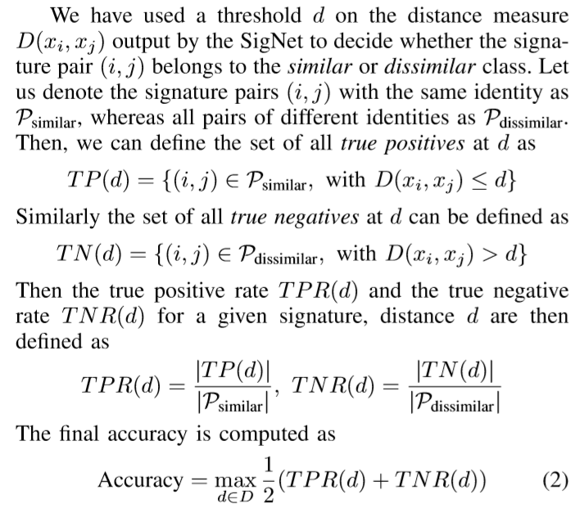
Performance Evaluation
Notes:
They evaluate the performance of the network using 3 metrics: Accuracy, False Acceptance Rate, False Rejection Rate.
Higher accuracy is better and lower FAR and FRR are better. But the most important is to achieve low FAR scores

Slide 32
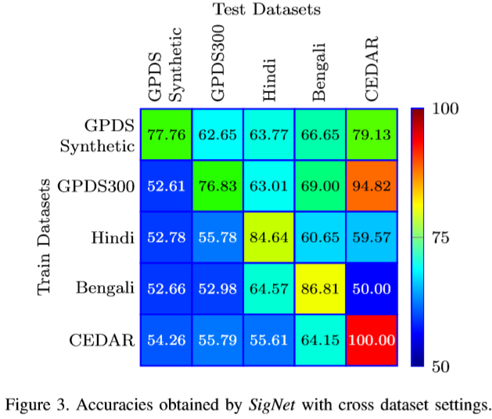
Cross datasets
Notes:
They evaluate the performance of the network using 3 metrics: Accuracy, False Acceptance Rate, False Rejection Rate.
Higher accuracy is better and lower FAR and FRR are better. But the most important is to achieve low FAR scores

Slide 33
6.
SigNet: Convolutional Siamese Network for Writer Independant Offline Signature Verification on the BHSig260 database (Hindi)
Lundi 30 Mars 2020

Slide 34
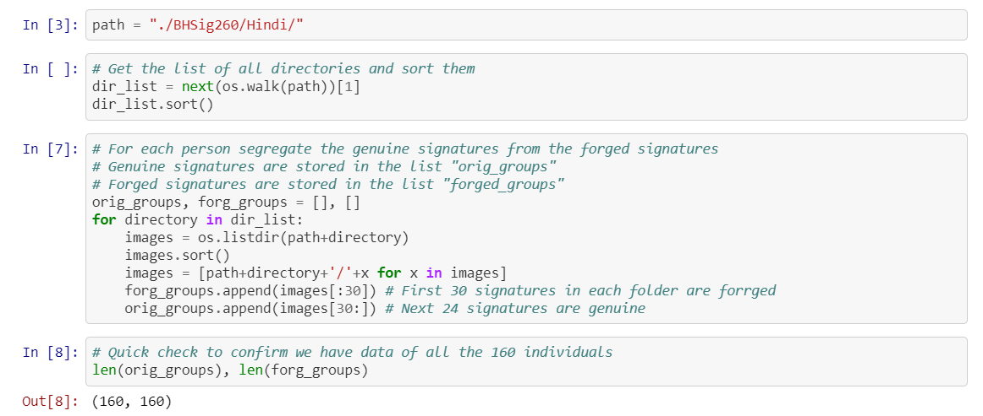

Slide 35
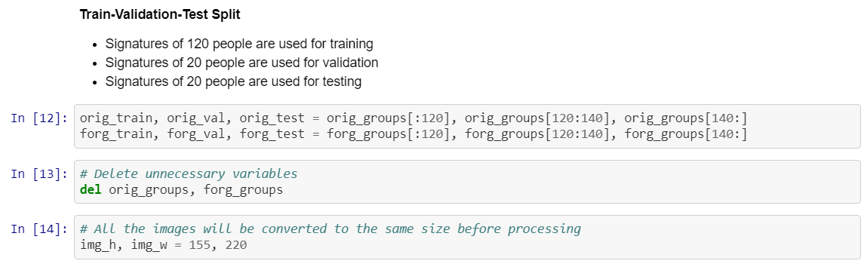

Slide 36
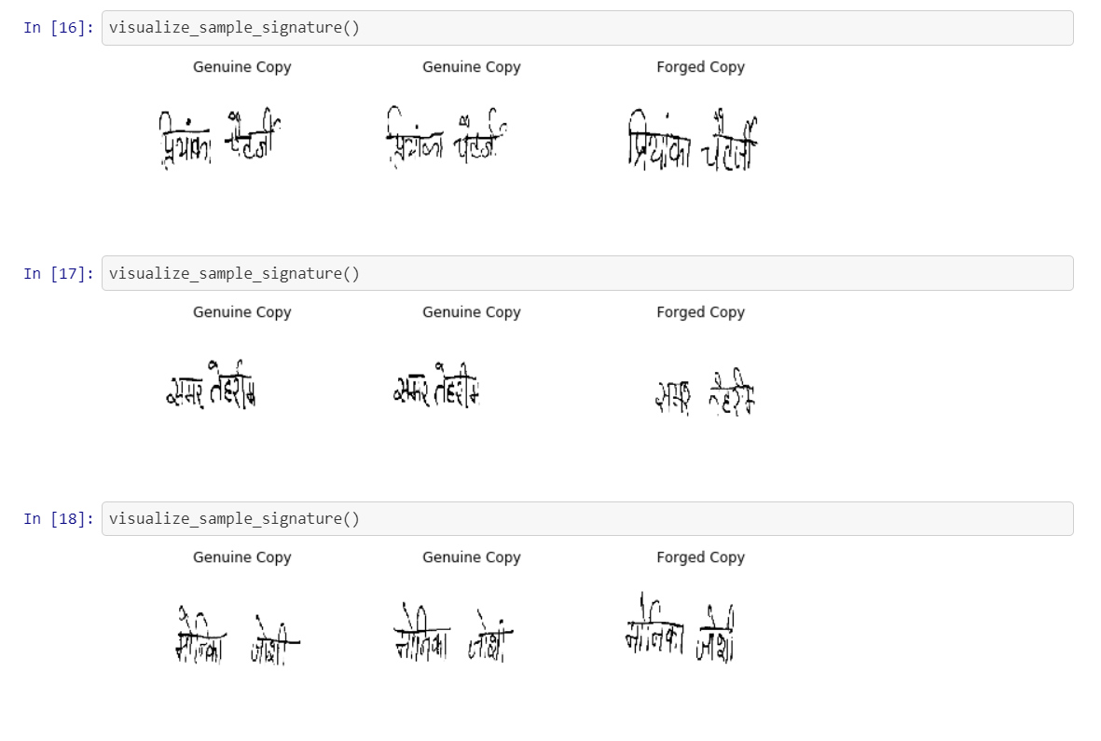

Slide 37
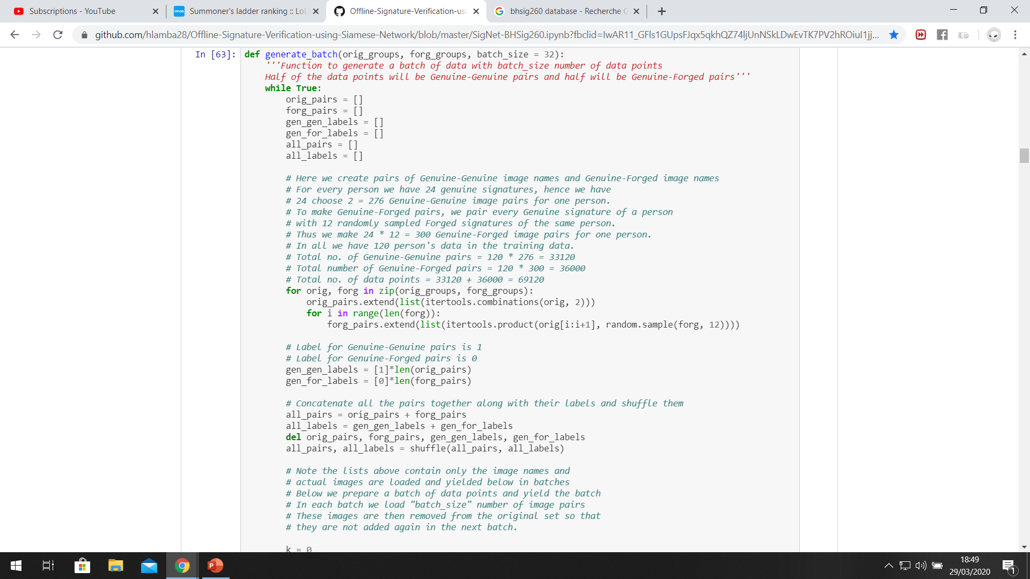
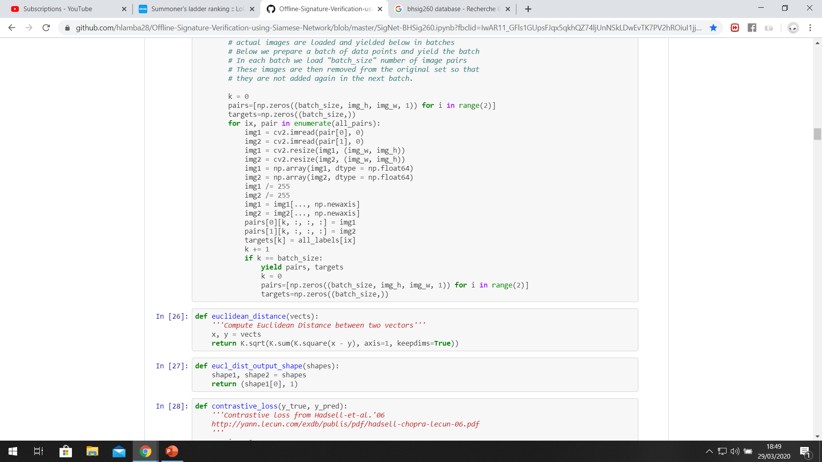
Notes:
Before k=0 : Note the lists above contain only the image names and actual images are loaded and yielded below in batches, Below we prepare a batch of data points and yield the batch In each batch we load "batch_size" number of image pairs, These images are then removed from the original set so that # they are not added again in the next batch.

Slide 38
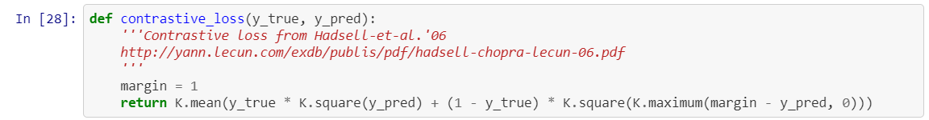
Loss function
Notes:
Before

Slide 39
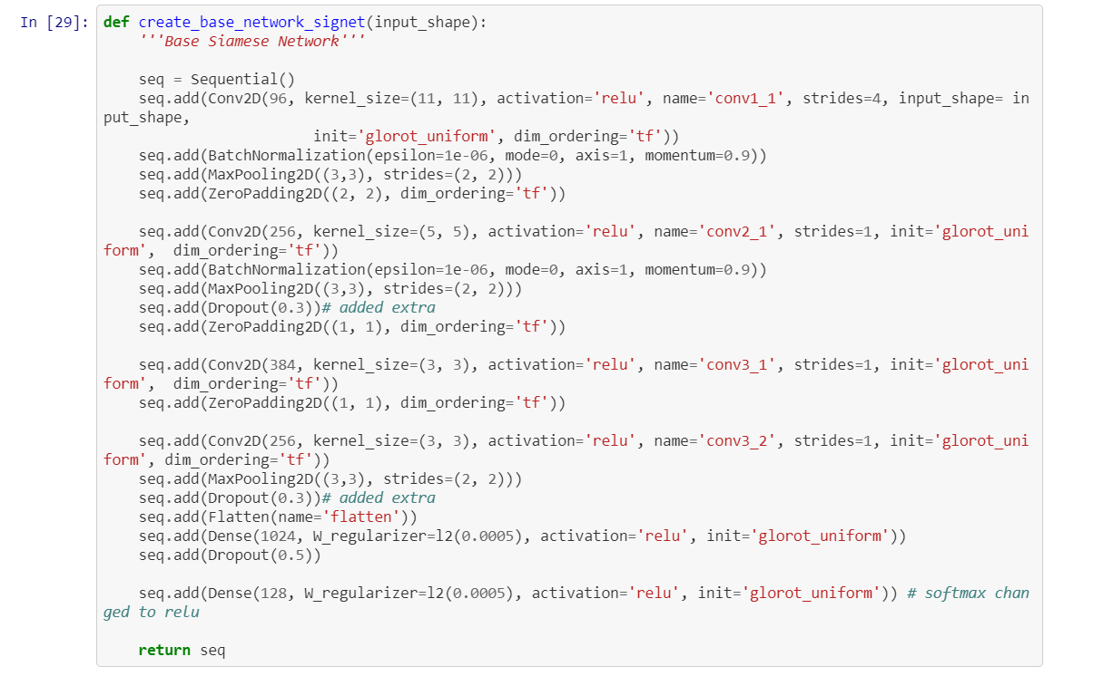
Model architecture

Slide 40
Architecture du modèle

Slide 41
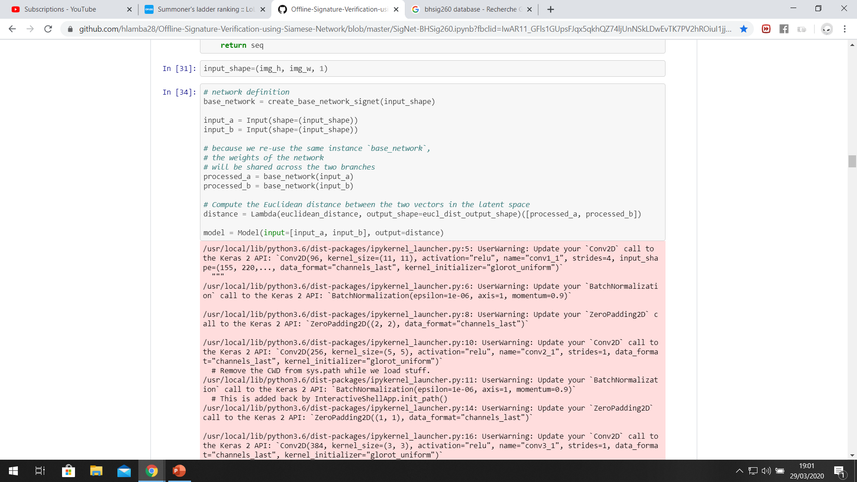
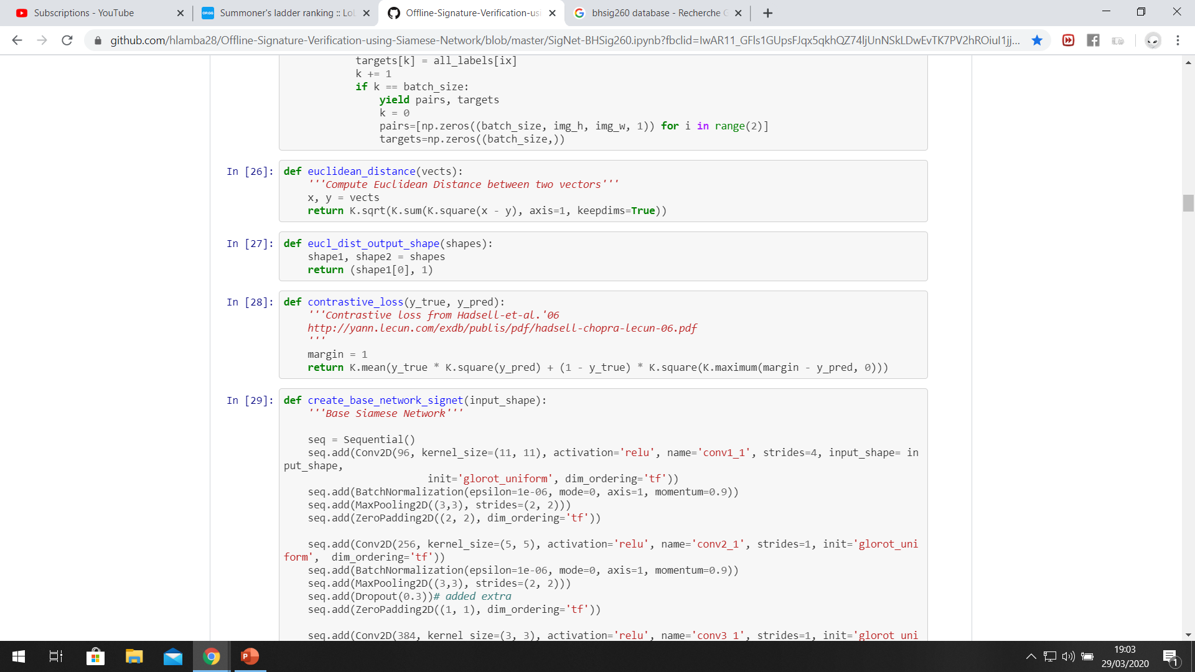

Slide 42
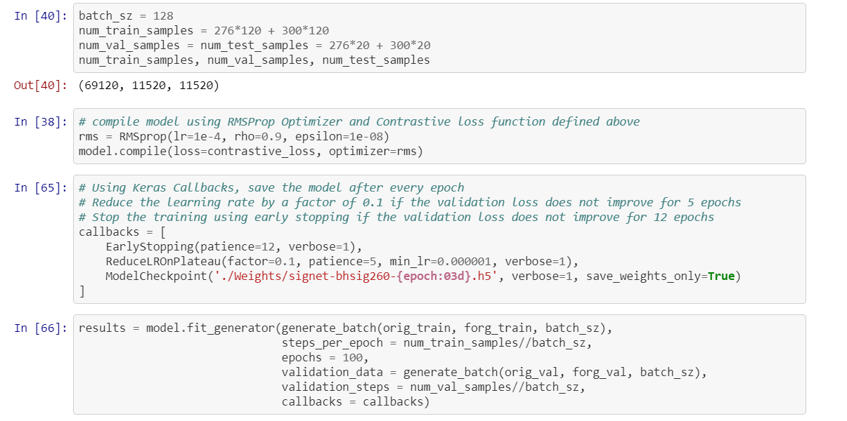

Slide 43
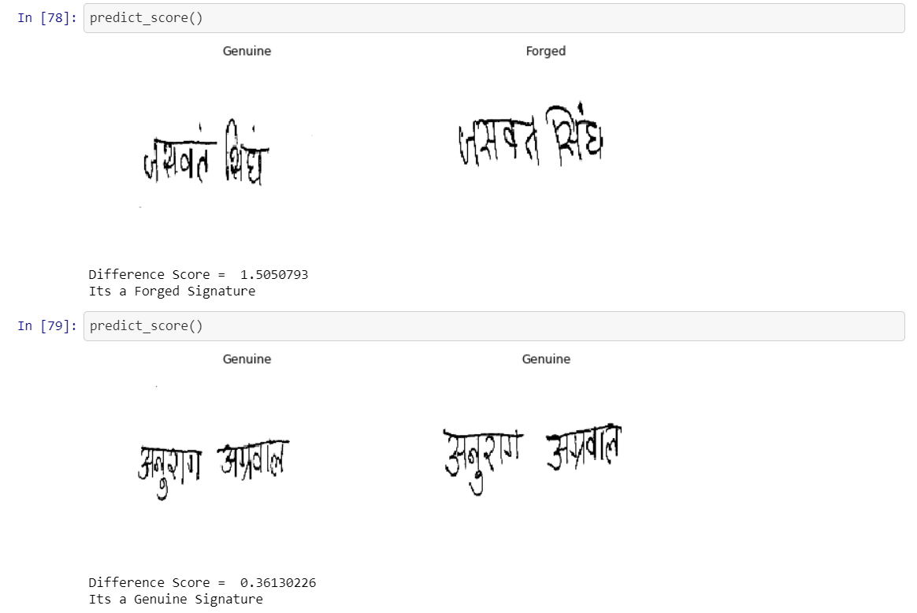
Results

Slide 44
THANKS!
😉

